Slide 1
L4/5 GROUP 2
Jordan Marks
Alice Baker
Thomas Gibbs
Daniel Pokladek

Slide 2
The brief
Physics based game
Easy to learn game yet hard to master

Slide 3
Logline and target audience
Logline – Beat your Foes in this gravity based planetary arena.
Target audience - 18-35 Male and Female
Platform – Mobile

Slide 4
Game
What the player does
Physics in the game
Turn based game play.

Slide 5
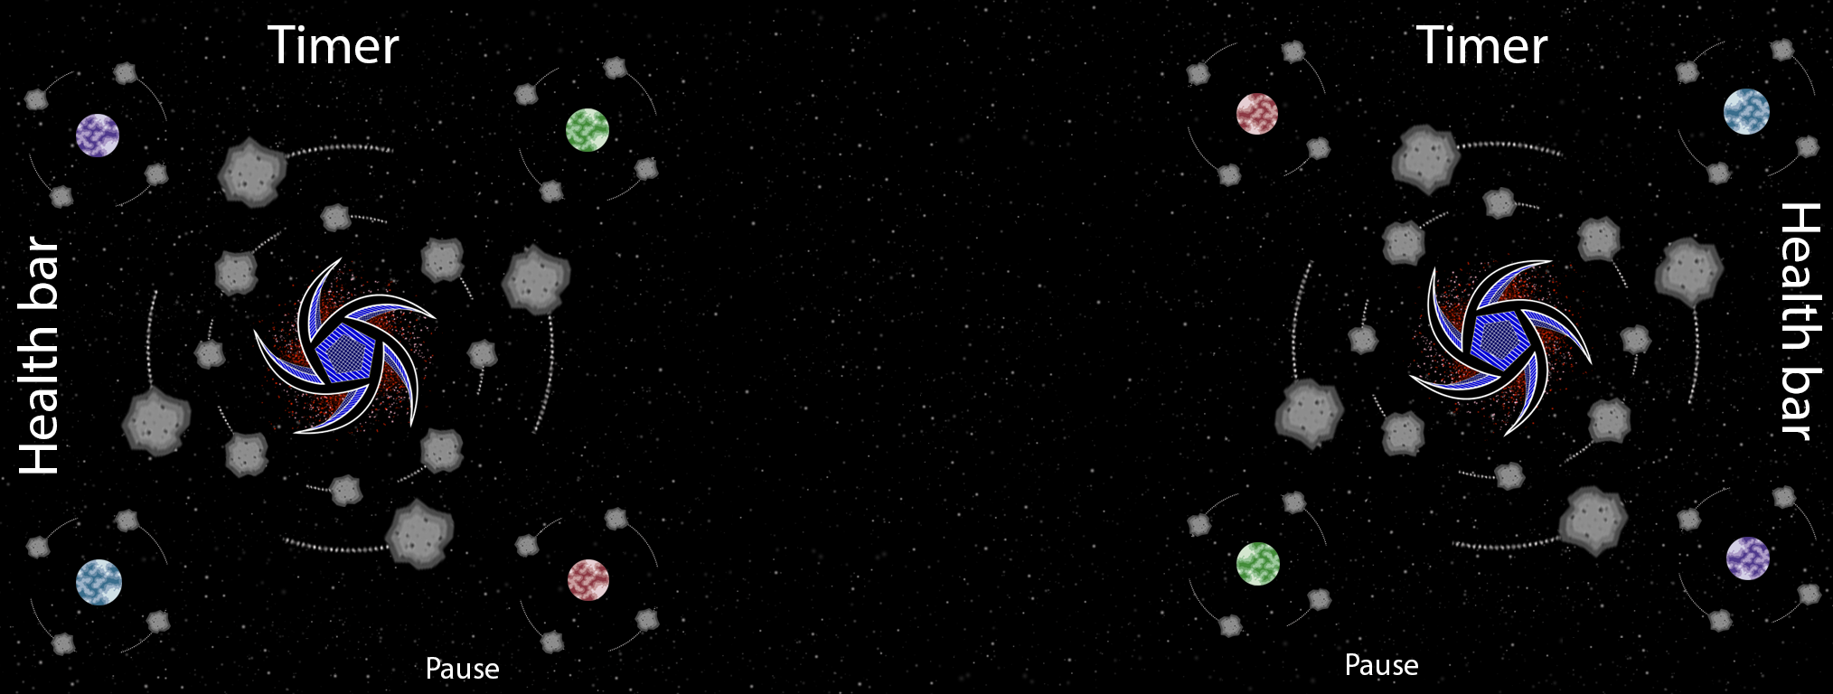
UI

Slide 6
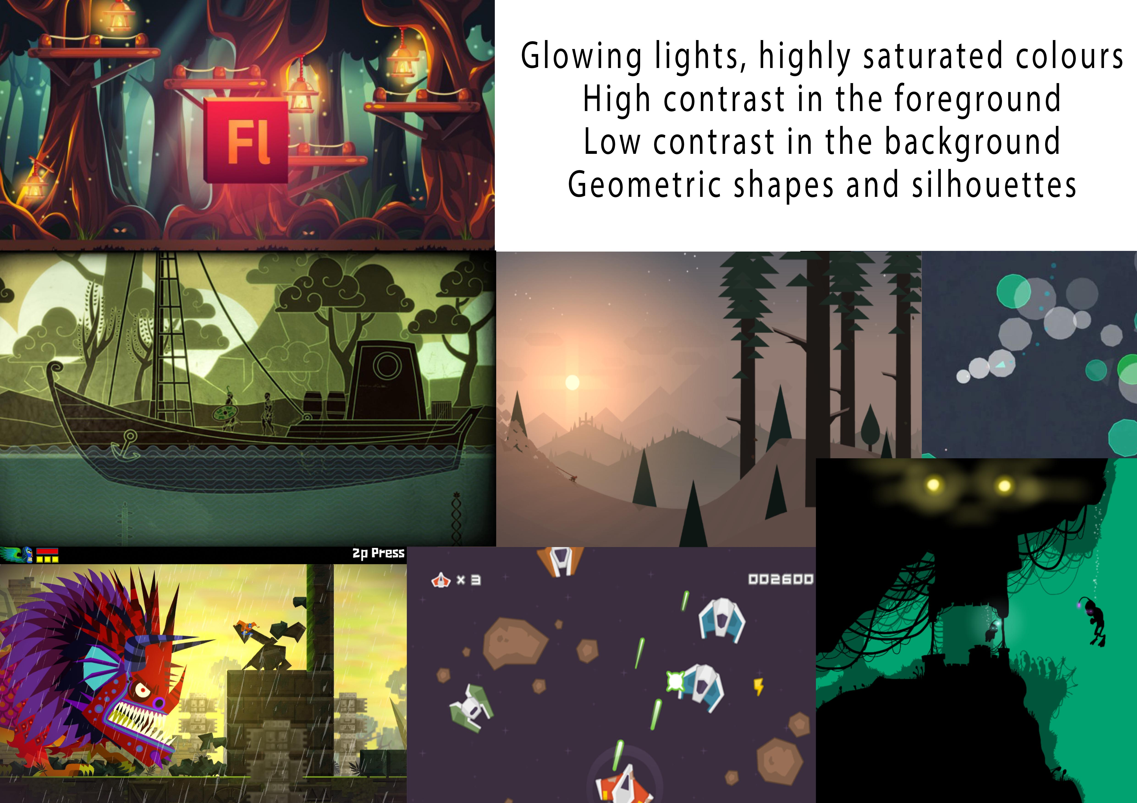
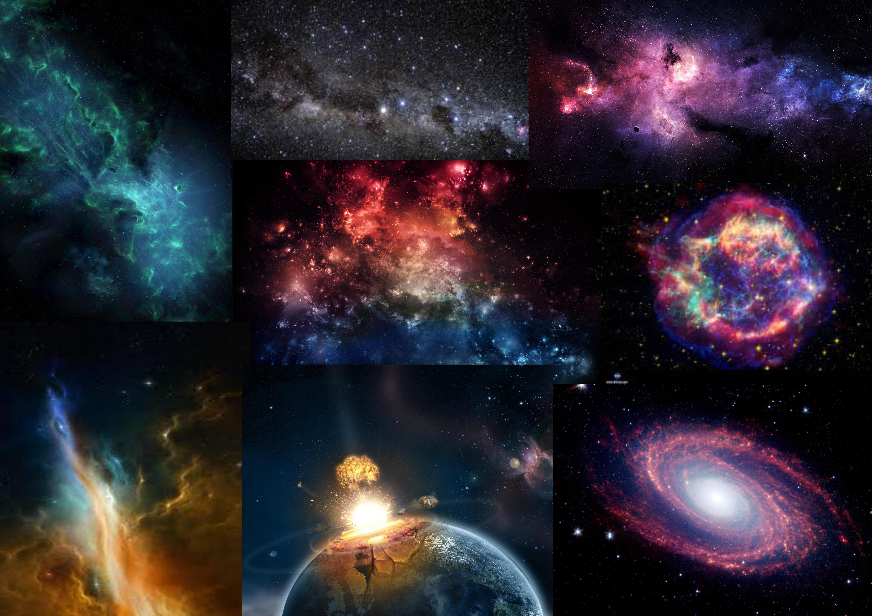
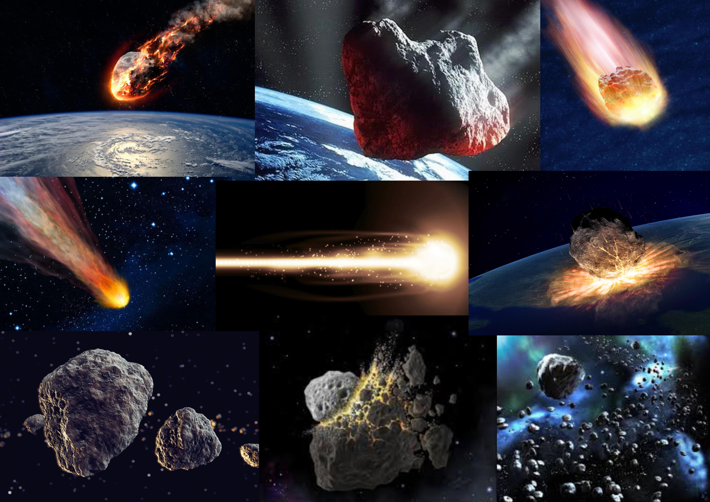

Art style and Moodboard

Slide 7
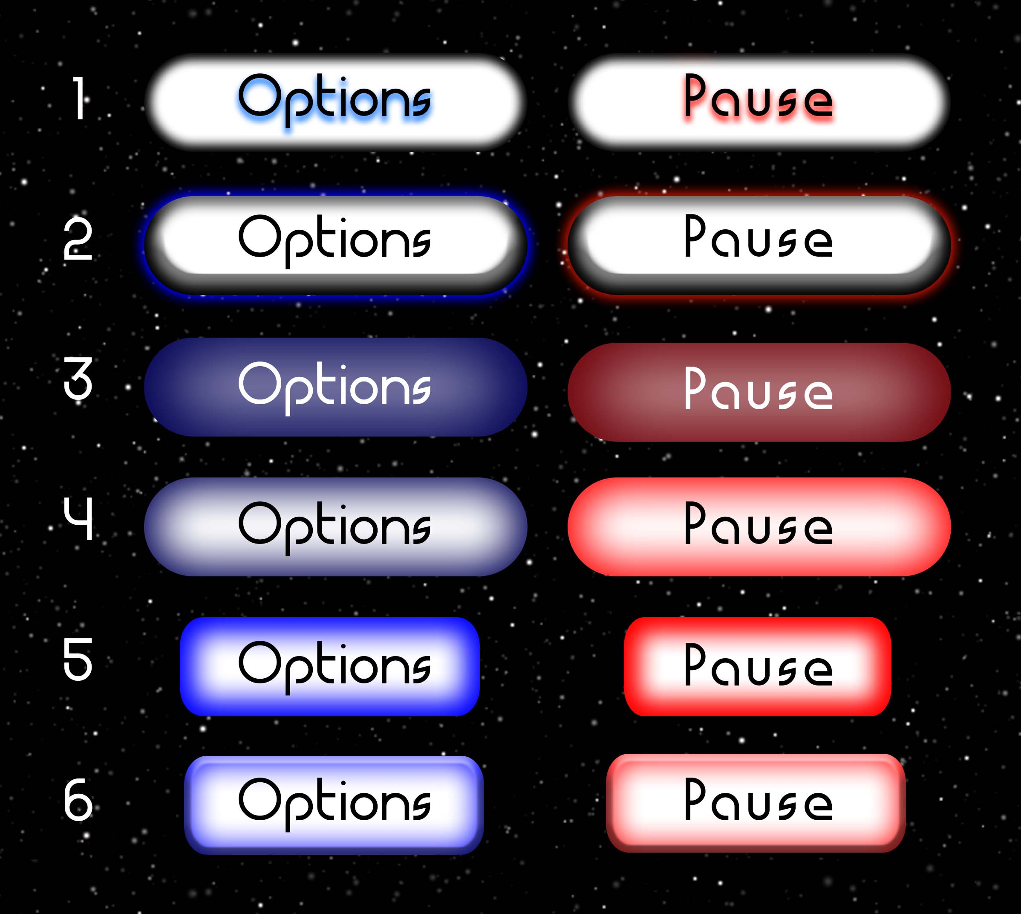
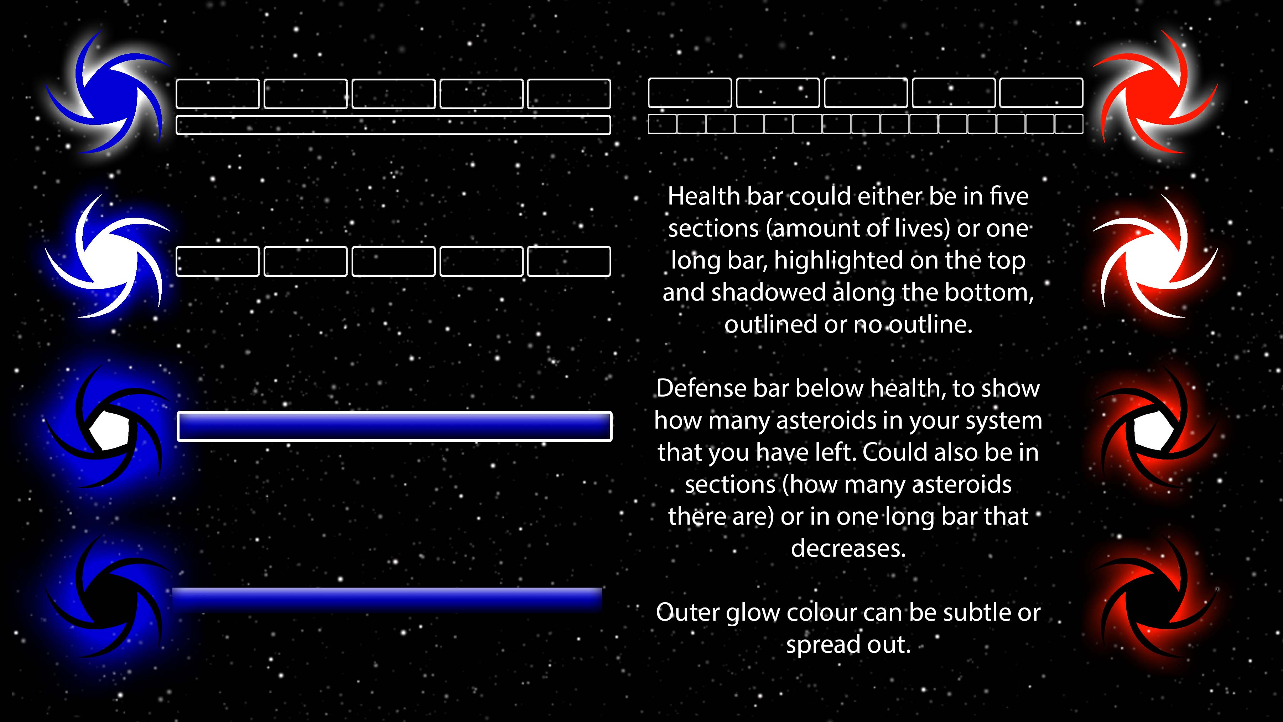
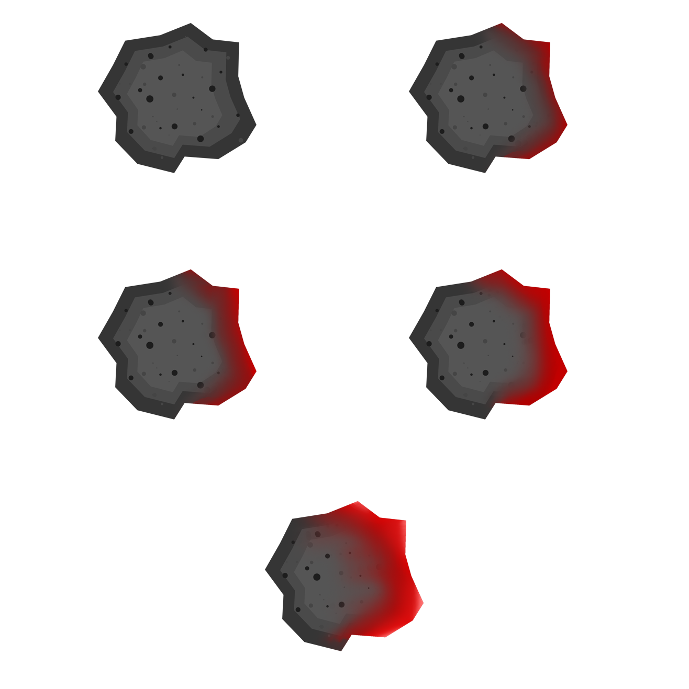

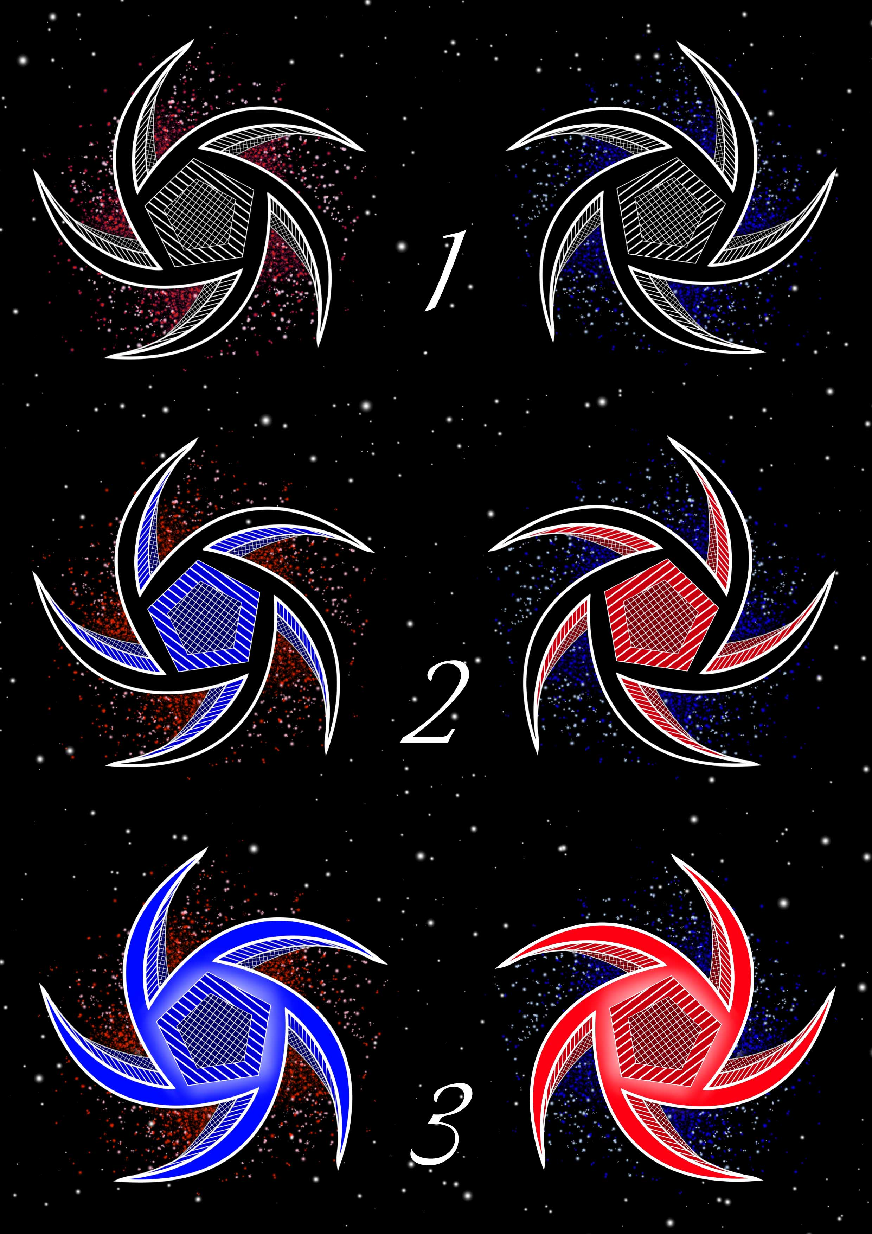
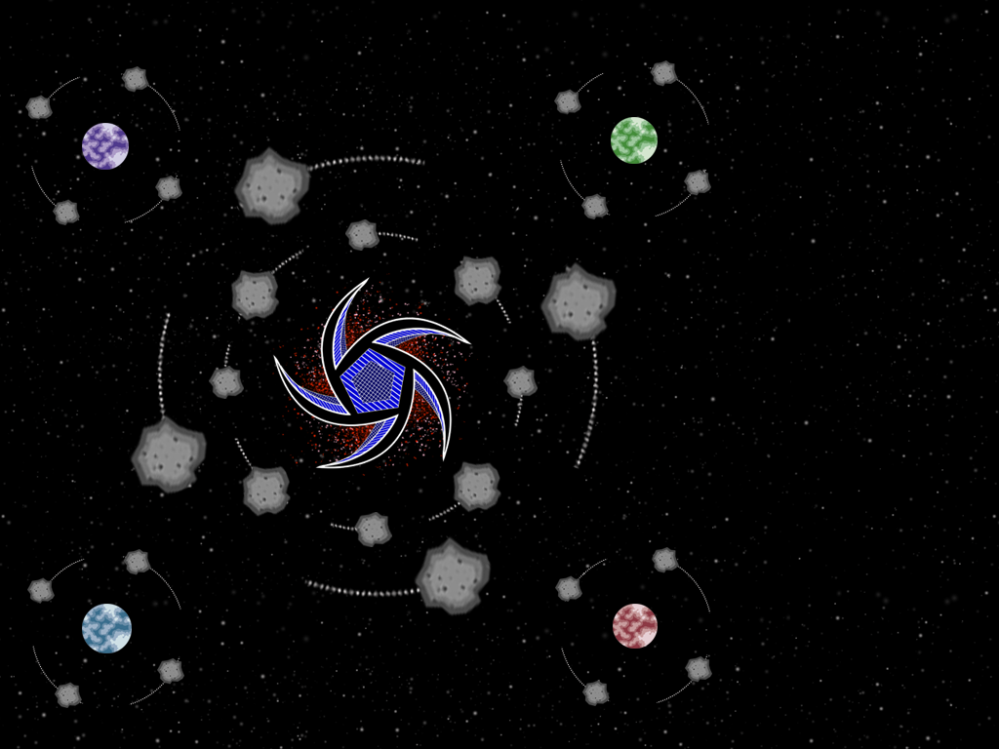

Game art

Slide 8
Prototype

Slide 9
Management (work hours and emails)
Hours of work
Jordan: 24/24
Alice: 24/24
Dan: 27/24
Tom: 26/24
Emails
Jordan:
Alice:
Dan:
Tom:

Slide 10
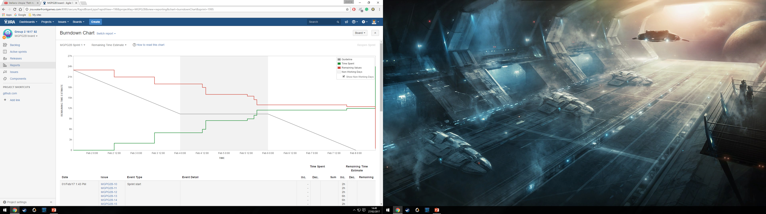
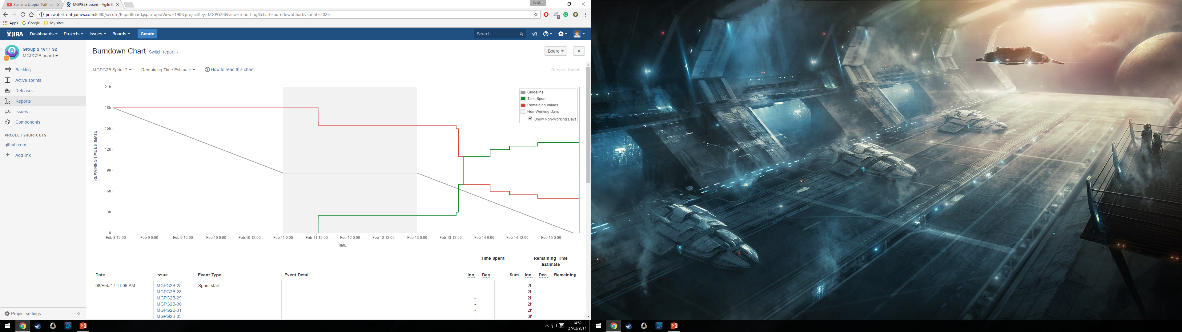


Slide 11
Questions?

